Slide 1
Middleware
By
Jitendra Singh Tomar || Jeetu

Slide 2
Topics to discuss
Introduction to Webservices
Administration of Product Installation and configuration
Working with profiles
Working with nodes in a Network Deployment/Cluster environment
Working with application server
Working with clusters

Slide 3
What is Middleware?
Middleware is software that acts as a bridge between an operating system or database and applications, especially across a distributed network.
It enables different systems, applications, and components to communicate, coordinate, and manage data and processes.
In simple terms: Middleware is the "glue" that connects different applications or systems in a scalable, secure, and reliable way.

Slide 4
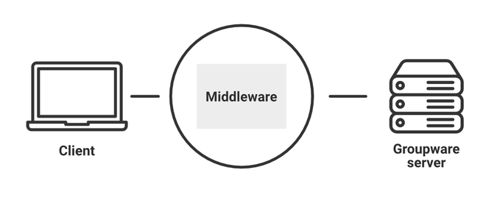
Where Does Middleware Fit?
It provides essential services like:
Communication
Messaging
Authentication
Load balancing
Transaction management

Slide 5
Core Functions of Middleware
Communication
Manages data exchange between applications using protocols (e.g., HTTP, JMS, TCP).
Integration
Connects heterogeneous systems (e.g., Java app to .NET service).
Security
Adds authentication, authorization, and encryption.

Slide 6
Core Functions of Middleware
Scalability & Load Balancing
Distributes traffic to handle growing workloads.
Transaction Management
Manages multi-step operations reliably (especially in banking, ERP).
Logging & Monitoring
Tracks performance, errors, and transaction status.

Slide 7
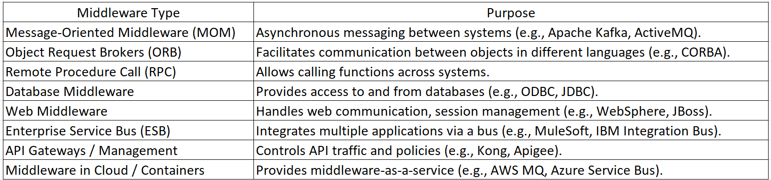
Types of Middleware

Slide 8
Popular Middleware Platforms
IBM WebSphere
Red Hat JBoss EAP
Oracle WebLogic
Apache Kafka
RabbitMQ
MuleSoft
TIBCO
Azure Service Bus
Amazon MQ / SQS

Slide 9
Why is Middleware Important?
Reduces development complexity.
Enables interoperability across platforms.
Improves scalability and resilience.
Centralizes security, monitoring, and logging.
Supports distributed systems and microservices.

Slide 10
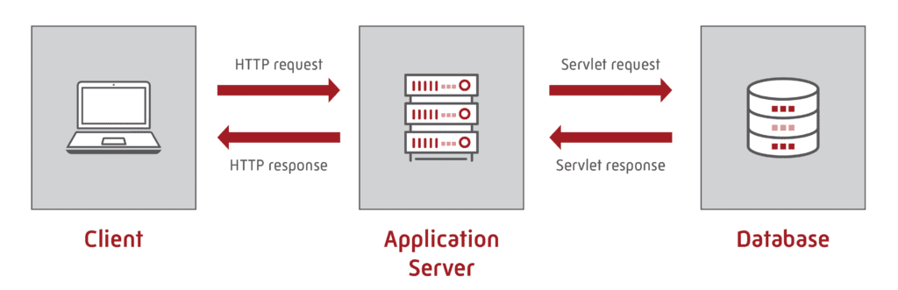
What is an Application Server?
An Application Server is a middleware software platform that provides runtime environments, APIs, and services for developing, deploying, and managing enterprise-level applications, especially web-based or distributed applications.

Slide 11
Core Functions:
Application Execution
Hosts and runs business logic (Java EE, .NET, etc.)
Resource Management
Manages connections to databases, messaging, etc.
Security Services
Authentication, authorization, role-based access
Session Management
Tracks and maintains client session states
Transaction Management
Ensures atomicity, consistency, isolation, durability (ACID)
Web Container
Hosts and serves dynamic web content (e.g., JSP, Servlets)
Messaging Support
Integrates with JMS, MOM for asynchronous communication

Slide 12
Examples of Application Servers
Product | Platform / Tech
IBM WebSphere | Java EE
Oracle WebLogic | Java EE
Red Hat JBoss EAP | Java EE
Apache Tomcat | Lightweight Java servlet container
Microsoft IIS + .NET | Windows/.NET
GlassFish | Open-source Java EE server

Slide 13
What are Integration Endpoints?
Integration Endpoints are the entry or exit points of a system or service that allow data exchange or interaction between systems, applications, or services in an integration scenario.
Think of them as connection interfaces exposed by applications or middleware that allow them to communicate with other systems.
Middleware connects the endpoints, handles how data flows, converts formats (if needed), and ensures everything happens securely and reliably.

Slide 14
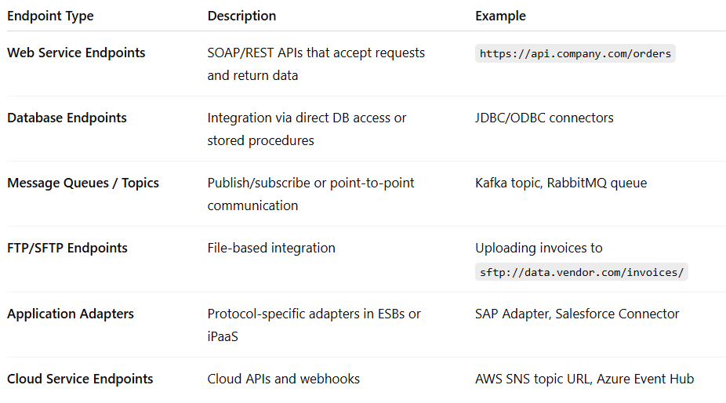
Types of Integration Endpoints

Slide 15
Endpoint Configuration Includes
Protocol: HTTP/S, JMS, TCP, FTP
Authentication: OAuth, JWT, Basic Auth
Data Format: JSON, XML, CSV
Endpoint URI/URL: Target system address
Headers and Parameters: For customization

Slide 16
What Are Profiles in Middleware?
A profile in middleware is a ready-to-use environment or template that defines
how the middleware will operate
what services it includes,
how it's configured, and
what it's used for.
Profiles Are Used
To support different roles or purposes (e.g., development, testing, production)
To separate configurations cleanly
To enable modular installations
To make administration and maintenance easier

Slide 17
Examples of Middleware Profiles
IBM WebSphere Application Server (WAS)
Default Profile
A typical app server profile with admin console.
Admin Profile
Only has the administrative tools (no runtime).
Managed Profile
Used in a cell as a node, controlled by a Deployment Manager.
Deployment Manager (DMGR)
Controls multiple nodes in a cluster.
Custom Profile
Lightweight profile created with your specific needs.

Slide 18
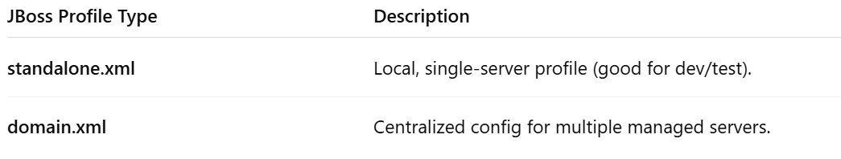
Examples of Middleware Profiles
JBoss / WildFly
While JBoss doesn’t use the word "profiles" in the same sense, it has configuration profiles in its standalone.xml and domain.xml files:

Slide 19
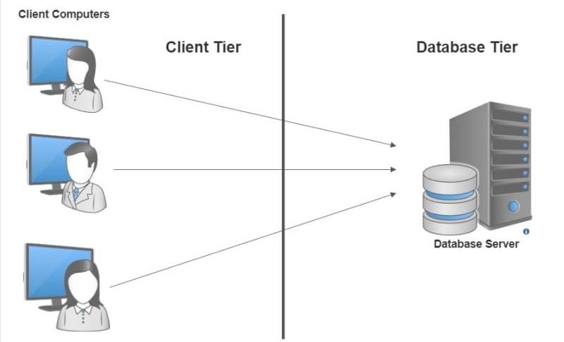
Two tire architecture

Slide 20
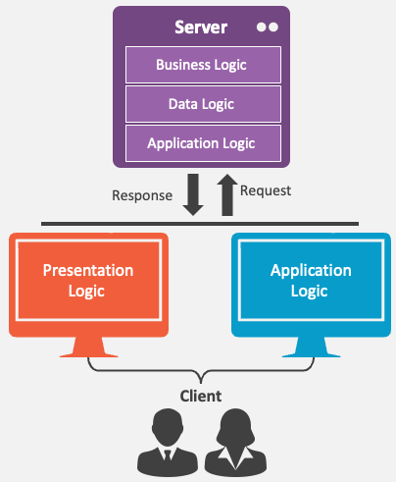
Two tire architecture
Two-tier architecture is a client-server model where an application is divided into two layers:
Client Tier (Presentation + Logic)
Data Tier (Database Server)
Limitations
Harder to scale (clients overload the DB server)
Security risks (direct DB access from user machines)
Maintenance issues (client-side logic updates are harder to deploy)

Slide 21
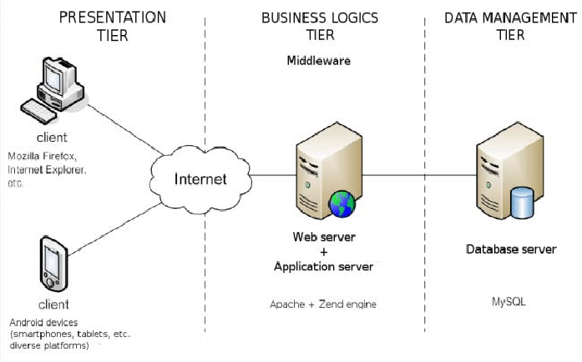
Three-Tier Architecture
A three-tier architecture is a software design model that separates an application into three logical layers:
Presentation Tier
Application (Logic) Tier
Data Tier

Slide 22
Three-Tier Architecture – Presentation Tier
Presentation Tier (Client Layer)
What it does?
It's the front-end that users interact with.
Examples:
Web browser, mobile app, desktop app UI.
Technology:
HTML/CSS, JavaScript, Angular, React, Android, iOS.
Sends requests to the middleware and displays responses to the user.

Slide 23
Three-Tier Architecture – Application Tier
What it does: This is the middleware layer. It contains the business logic, rules, workflows, and integrations.
Examples: Application servers, APIs, Web Services, ESBs.
Technology:
Java EE (e.g., JBoss, WebLogic, WebSphere)
.NET
Node.js
Spring Boot
MuleSoft, Apache Camel (for integration logic)
Acts as a bridge between the UI and the database. This is where most of the logic happens.

Slide 24
Three-Tier Architecture – Data Tier
Data Tier (Database Layer)
What it does?
Stores, retrieves, and manages the application’s data.
Examples:
Oracle, MySQL, PostgreSQL, MongoDB.
Technology:
RDBMS, NoSQL, Cloud storage.
The application tier connects to this layer to fetch, update, or delete data.

